Slide 1
Ion Implantation

Slide 2
Contents
General Introduction
Ion Implant
  Introduction
  Application
  System Overview
  Beam Wafer Interaction
  Annealing
  RTP

Slide 3
Introduction
Introducing dopants into the silicon crystal can alter the “type” of the silicon
  from n type to p type and vise versa
Dopants are usually introduced in a two stage process
Predeposition and Drive-in
Implant and Drive-in (anneal)

Slide 4
Doping the Silicon
Field
Oxide
POLY
Field
Oxide
P+
+++++++++
P+
- - - - -
- - - - - -
Field
Implant
P+ Source
Drain
N WELL
Vt Adjust

Slide 5
Doping the Silicon 2
In older processes the Source /Drain regions were doped using Thermal Diffusion
With the maturing of implant technology, CMOS processes became possible because of the greater control over the dopant quantities introduced to the silicon
In CMOS processes up to about the 130nm node all of the doping with the exception of the saturation doping of polysilicon was done by implantation.
Below the 130nm node this is also now done by implant with the poly doped N-Type over the N-Channel and P-Type over the P-Channel

Slide 6
Process Overview
Ion implantation is an enabling technology
Single MOS processes were possible prior to the development of implantation
Furnace doping techniques are too coarse for the fine control needed in the doping of the well regions in CMOS processes
Furnace doping saturation dopes the surface during the pre-deposition stage, whereas implantation can control the dopant quantity down to the 10¹¹ cm⁻² region

Slide 7
SYSTEM OVERVIEW
ION SOURCE
MASS ANALYSIS
ACCELERATION
SCANNING
DOSE MEASUREMENT
VACUUM SYSTEM

Slide 8
ION IMPLANTER SCHEMATIC
Acceleration
Voltage
Electro-
Scanning
Neutral Trap
magnet
High Voltage
Terminal
Y
X
Focus
Wafer
System under vacuum
Typically 10⁻⁸ Torr
7.5 x 10⁻¹⁰ Pa
Extract Voltage
Source
Filament
Gas In
Ion Implanter

Slide 9
ION SOURCE
extraction
electrodes
N
gas feed
20kV
+
electron
path
S

Slide 10
IMPLANT GASES
SPECIES
IMPLANTED
SPECIES
SOURCE
DOPANT
TYPE
BORON B¹¹ BF₃ P TYPE
PHOSPHOROUS P³¹ PH₃ N TYPE
ARSENIC As⁷⁴ AsH₃ NTYPE

Slide 11
MASS ANALYSER MAGNET
B=(2mV/qr²)^{1/2}
B=MAGNETIC FIELD STRENGTH
m=ION MASS
V=ACCELERATING VOLTAGE
q=ION CHARGE
r=MAGNET RADIUS
Magnet
Heavier ions
(BF+)
Lighter ions
Magnet
Desired ion
(B+)
MASS SELECTION MAGNET

Slide 12
MASS ANALYSIS
BF₃ MASS SPECTRUM
11
B F₂
BEAM
CURRENT
11
B F
11
B
F
10
10
B F₂
B F
10
B
5 10 15 20 25 30 35 40
AMU

Slide 13
ACCELERATING COLUMN
high voltage
terminal
ion
path
20keV
+180kV

Slide 14
ACCELERATION
ION ENERGY
ION ENERGY = CHARGE ON ION X ACCELERATING VOLTAGE
ION CHARGE = 1
ACCELERATING VOLTAGE = 50kV
ION ENERGY = 50keV
ION CHARGE = 2
ACCELERATING VOLTAGE = 50kV
ION ENERGY = 100keV

Slide 15
FOCUS
Beam
Monitor
Beam

Slide 16
SCANNING
Electrostatic Scanning
  Used on medium current machines
Mechanical scanning
  used on high current machines
Hybrid scanning
  used on medium current systems on large wafer sizes (8 inch)

Slide 17
ELECTROSTATIC SCANNING
WAFER
Y Scan
X Scan
X and Y Scan

Slide 18
MECHANICAL SCANNING
rotation
direction
wafer
scan
direction
Stationary Beam
Wafer Moved
Mechanically
in X and Y
Direction

Slide 19
HYBRID SCANNING
X Scan
Electrostatically
Wafer Moved
Mechanically
in Y Direction

Slide 20
NEUTRAL TRAP
Deflector Plates
Neutrals
BEAM
7deg.

Slide 21
DOSE MEASUREMENT
FARADAY CAGE
+
WAFER
e
-
A
DOSE : IONS/cm²

Slide 22
DOSE MEASUREMENT
Typical dose ranges
CMOS wells 1e12-1e13 ions/cm²
Threshold adjust implants 1e11-1e12 ions/cm²
Source drain implants 1e15-1e16 ions/cm²

Slide 23
ION IMPLANTATION
BEAM WAFER INTERACTION

Slide 24
MATHEMATICAL MODEL
Ions lose energy in collisions with atoms in the silicon lattice (Target Atoms)
Two types of collision
  Nuclear collisions
    Transfer of energy to the target nuclei
  Electronic collisions
    Interaction of the charged ion with the electron cloud of the target atom
The total distance
travelled in the Silicon
is called the Range⇒ R

Slide 25
IMPLANT MODELLING
Rp Average range of ions in the wafer
Distribution around the range
Computer models are used to simulate range of ions in the lattice
Silicon
Np
Surface
Conc
Ions
Rp
unlucky
lucky
Rp
Rp
3 Rp

Slide 26
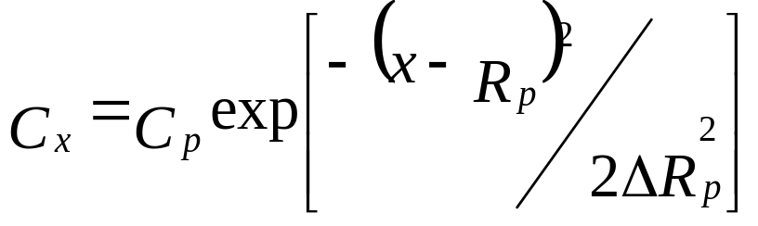
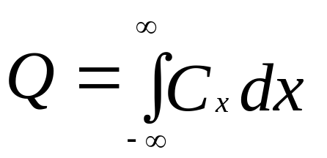
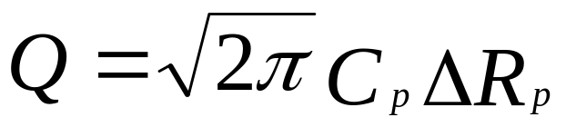
Gaussian Expression
The expression which describes this distribution is
The area under the Gaussian curve is the implanted dose and is equal to
For an implant completely contained within the silicon the dose is equal to

Slide 27
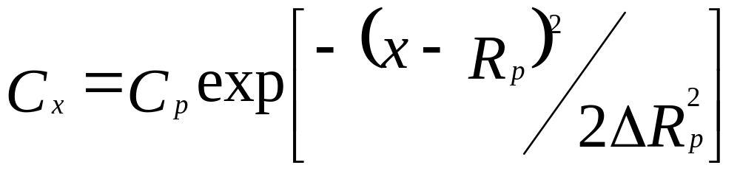
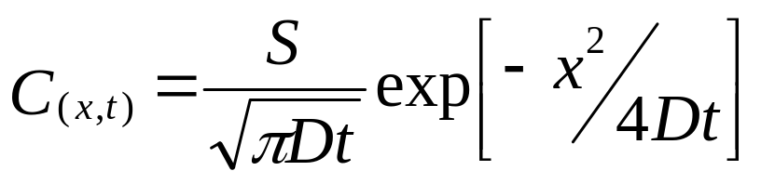
Similarity to The Diffusion Equation
Note how similar the implant concentration expression is to the diffusion equation
4Dt is represented by 2ΔRp²
Similar but the distribution is shifted along the x axis by a distance R_{p}

Slide 28
Junction Formation
The junction between the P/N region occurs where the concentration of the introduced dopant is equal to the background dopant concentration
Conc.
Cs
diffused dopant
background
Cb
N
x_{j}
0
x_{j}
X
P

Slide 29
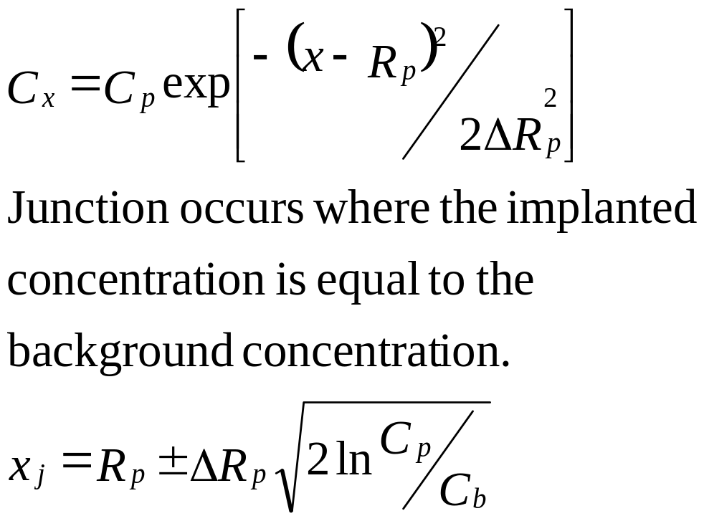
JUNCTION FORMATION
High energy implant
Two junctions can be formed during implant
C
Cb
Cb (Nb)
X
xj1
Rp
xj2

Slide 30
JUNCTION FORMATION
Peak concentration normally at surface of the silicon, the oxide/silicon interface
Ions
Silicon
Oxide
Implant peak
Xo
X

Slide 31
IMPLANT MASKING
Ions
Normally the implant energy is chosen to put the peak of the implant just at the oxide/silicon interface
This mimics the type of junction profile formed with thermal doping
Silicon
Implanted ions not
Oxide
required in this area
Implanted ions required in
this area
Xo
X

Slide 32
Channeling
Channelling is where incident ions fly between the target atoms in the silicon lattice
The ions do not have collisions as early as “expected”
This means that ions travel further than the models would normally predict

Slide 33
Prevention of Channeling
Wafer normally tilted to avoid channeling
Implant oxide also helps to reduce channeling by scattering ion beam
Normal
Incidence
beam
scattered
beam
oxide
Tilted Wafer

Slide 34
Channeling Affect
Exponential tail due to channeling in wafer
Conc
Exponential
Tail
Depth

Slide 35
DAMAGE
Electronic collisions
  ions lose energy due to excitation of electrons in silicon wafer
Nuclear collisions
  collisions between ions and atoms in the wafer
For the same energy heavy ions create more damage close to the surface
  Even light ions lose the last of their energy through nuclear collisions
Light Ions
Heavy Ions

Slide 36
ANNEALING
Vacancy
Pre Anneal
dopant atom
host atom
Post Anneal
dopant atom
host atom

Slide 37
ANNEALING
Heavier ions create an amorphous layer at the surface
A lower annealing temp. required at high doses due to formation of this amorphous layer
The effect is know as “Solid Phase Epitaxial Growth”
The underlying still crystalline silicon acts as a seed for the recrystallization
TEMP
1000
900
BORON
800
700
PHOSPHORUS
600
500
10¹²
10¹³
10¹⁴
10¹⁵
10¹⁶
DOSE(IONS/cm²)

Slide 38
ION IMPLANTATION
RAPID THERMAL PROCESSOR

Slide 39
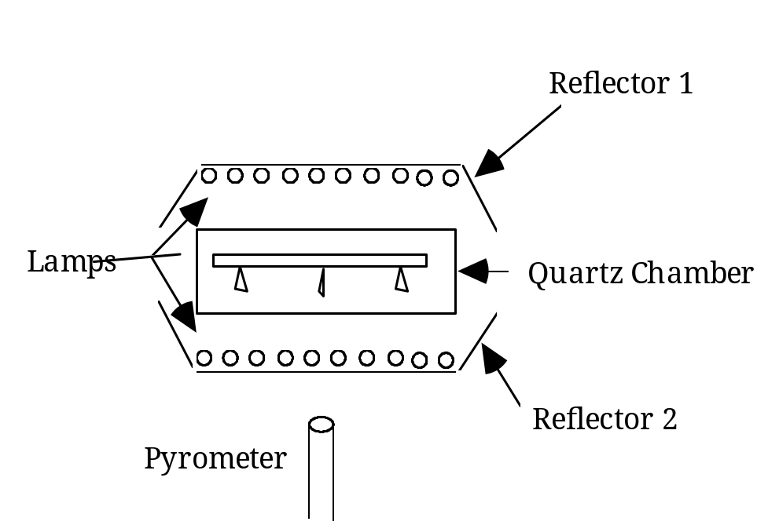
RAPID THERMAL PROCESSER

Slide 40
RTP
1000
800
600
400
200
0
WAFER
TEMP.
(°C)
10 20 30 40
TIME (sec)

Slide 41
ION IMPLANTATION
WAFER CHARGING

Slide 42
WAFER CHARGING
Positive ions arrive at wafer
Negative electrons removed from wafer
Charge builds up on wafer surface
Use source of electrons to neutralize the wafer charge
ELECTRONS
-
+
BEAM
WAFER

Slide 43
CHARGE NEUTRALISATION
Beam is scanned outside wafer
Ions hit graphite ring and knock out electrons
Electrons are carried to wafer surface
Electrons are used to prevent positive charge build up
GRAPHITE RING
WAFER
e
+
ion

Slide 44
Summary Implantation
Enabling technology
Modern processes all doping introduction by implantation
Implanted species must have a heat treatment after the implant
  To repair crystal damage
  To activate the implanted ions

